Slide 1
Machine Learning vs Las Vegas
Analyzing College Basketball Results Past to Model the Future

Slide 2
Disclaimer
NOTE:
To change images on this slide, select a picture and delete it. Then click the Insert Picture icon
in the placeholder to insert your own image.
The information in this presentation is for educational purposes only. If you or a loved one has a gambling problem, help is available. Please contact the National Problem Gambling Helpline Network at 1-800-522-4700 or at www.gamtalk.org. Help is available 24/7 and is 100% confidential.

Slide 3
Abstract
NOTE:
To change images on this slide, select a picture and delete it. Then click the Insert Picture icon
in the placeholder to insert your own image.
The goal of this project was to train a model to use historical college basketball game statistics and results compared to the betting odds, lines, and point spreads to generate predictions for upcoming games that would allow one to place lower-risk wagers and boost returns.

Slide 4
Background – Sports Betting
NOTE:
To change images on this slide, select a picture and delete it. Then click the Insert Picture icon
in the placeholder to insert your own image.
Why look at sports betting?
It is now legal in Colorado.
I’ve never participated in sports betting.
I’m a risk averse person.
Why choose college basketball as the topic?
Because I like it.
There are a lot of games and statistics available.
Unlike football, baseball, and hockey, all of a team’s players have the same statistics tracked.

Slide 5

Sports Betting at a glance Colorado - 2020
NOTE:
To change images on this slide, select a picture and delete it. Then click the Insert Picture icon
in the placeholder to insert your own image.
May 1, 2020 - sports betting became legal in Colorado.
14 operators have acquired Colorado sports betting licenses for launch in 2020.
10% of sports betting revenue will be levied as taxes to fund the Colorado Water Plan.

Slide 6
Sports Betting at a glance Nevada - 2019
NOTE:
To change images on this slide, select a picture and delete it. Then click the Insert Picture icon
in the placeholder to insert your own image.
191 total sports betting locations active.
$5.3 billion wagered by sports bettors.
Sports books kept $329 million.
Sports winnings accounted for only 2.74% of total casino wins.
Nevada Sports Betting Totals: 1984-2019. Las Vegas: Center for Gaming Research, University Libraries, University of Nevada Las Vegas, 2020.

Slide 7
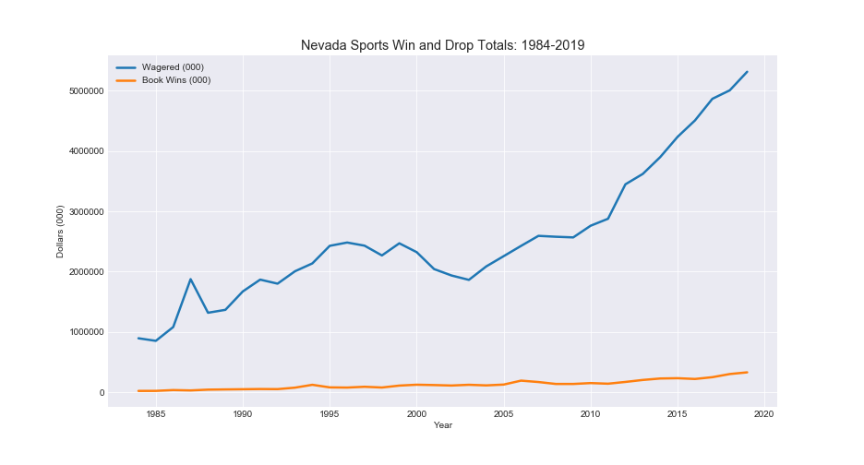
Nevada Sports Betting Totals 1984-2019
Book Wins is the amount the sports books kept for a calendar year (cash-in minus payoffs)
Wagered is an estimate of total amount wagered in a calendar year derived by dividing book wins by the reported book win percentage
Nevada Sports Betting Totals: 1984-2019. Las Vegas: Center for Gaming Research, University Libraries, University of Nevada Las Vegas, 2020.

Slide 8
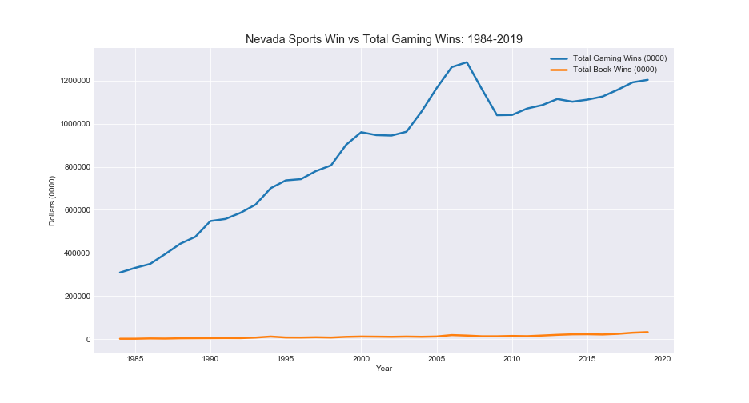
Nevada Sports Betting Totals 1984-2019
Comparison of total sports wins to total casino gaming wins over time
Total gaming wins for 2019 were > $12 billion
Sports wins accounted for $329 million of total wins in 2019
Nevada Sports Betting Totals: 1984-2019. Las Vegas: Center for Gaming Research, University Libraries, University of Nevada Las Vegas, 2020.

Slide 9
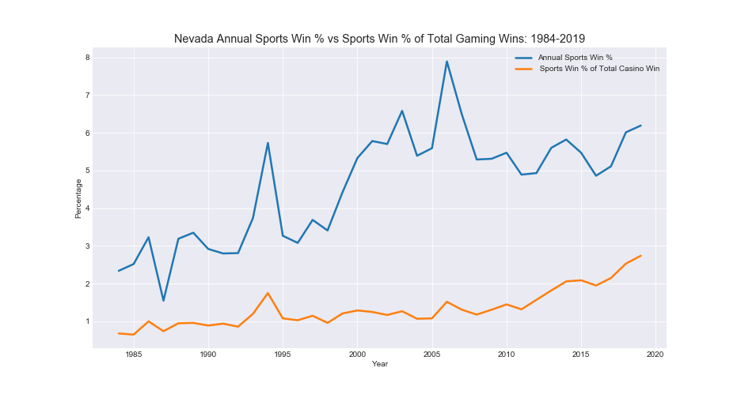
Nevada Sports Betting Totals 1984-2019
Comparison of total sports wins to total casino gaming wins over time
Percentage of total gaming wins has increased from 0.68% in 1984 to 2.74% in 2019
Nevada Sports Betting Totals: 1984-2019. Las Vegas: Center for Gaming Research, University Libraries, University of Nevada Las Vegas, 2020.

Slide 10
Sports Betting & College Basketball Quick Definitions
Point Spread or Line
Number assigned to represent the point difference between two teams
Meant to cause equal split of bettors on each team – “balanced action”
The team with a negative number (-4.5) is favored to win
Lines will move from the time it opens to close based on wagers placed on either side in order to balance the action
Moneyline Wagers
A wager on which team will win the game outright (without a point spread)
The team with a negative number (-180) is favored to win
The number represents the payout on a $100 wager
If the number is -180, the bettor needs to wager $180 to win $100
If the number is +145, the bettor needs to wager $100 to win $145
Totals or Over/Under
A wager on the total combined points of both teams in a half or the full game
If you bet ‘under’ 135.5 then you are hoping for 135 or fewer combined points to be scored

Slide 11
Data Sets
NOTE:
To change images on this slide, select a picture and delete it. Then click the Insert Picture icon
in the placeholder to insert your own image.
www.sports-reference.com
An API is available to capture schedule, team, and box score data
Capture data from the 2011 through 2019 seasons
106,370 games played after cleanup
www. sportsbookreviewsonline.com
Historical data in Excel files for historical scores and odds data from 2011 through 2019 seasons

Slide 12
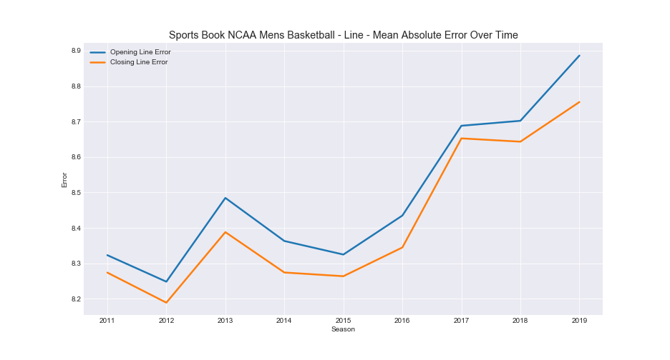
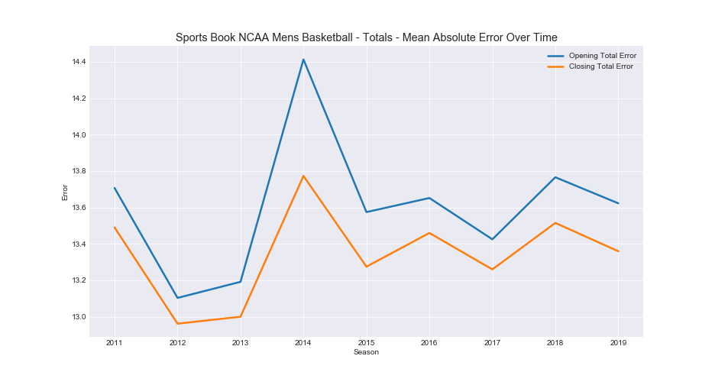
Sports Book Mean Absolute Error 2011-2019
Season long errors we’re targeting with our model
Season Opening Line MAE: 8.495
Season Closing Line MAE: 8.421
Season Opening Total MAE: 13.606
Season Closing Total MAE: 13.344
Citation: NCAA BASKETBALL SCORES AND ODDS ARCHIVES. Retreived from https://www.sportsbookreviewsonline.com/scoresoddsarchives/ncaabasketball/ncaabasketballoddsarchives.htm

Slide 13
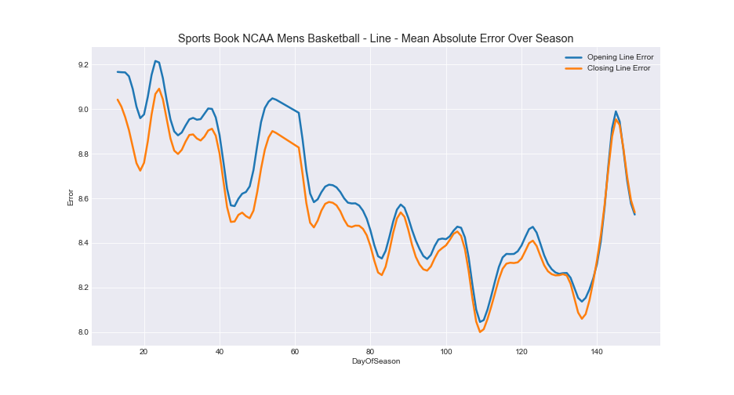
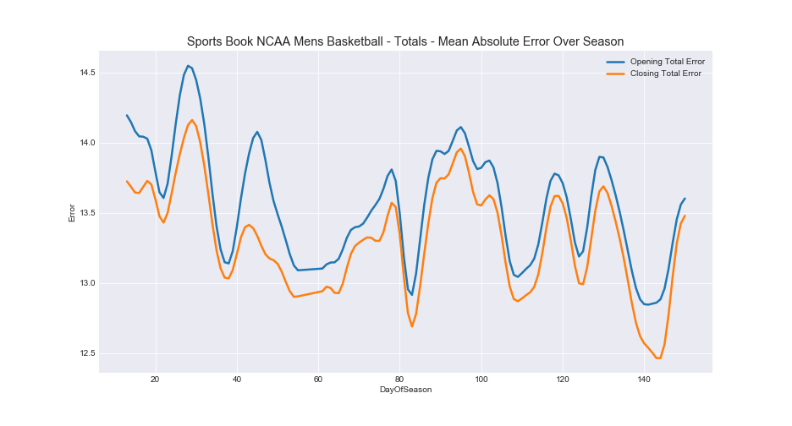
Sports Book Mean Absolute Error 2011-2019
Day of season error we’re targeting with our model
Day Opening Line MAE: 8.604
Day Closing Line MAE: 8.526
Day Opening Total MAE: 13.572
Day Closing Total MAE: 13.315
Citation: NCAA BASKETBALL SCORES AND ODDS ARCHIVES. Retreived from https://www.sportsbookreviewsonline.com/scoresoddsarchives/ncaabasketball/ncaabasketballoddsarchives.htm

Slide 14
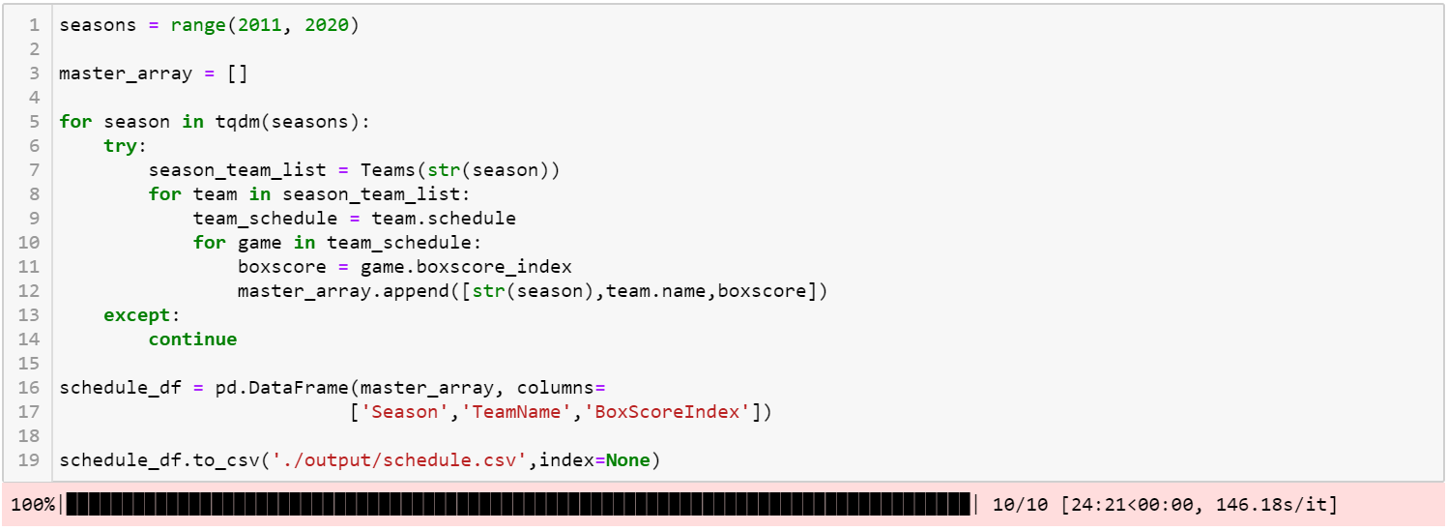
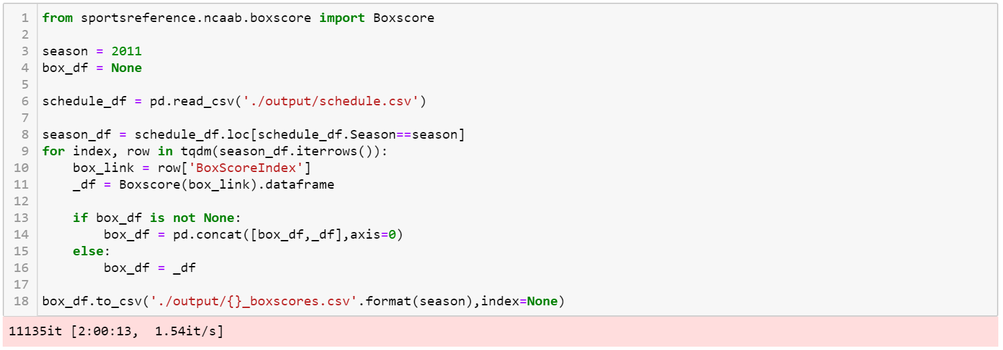
Collection – Cleansing – Compilation
API extract for Season, Team, and Box Score index
API extract by season for individual box scores
Added a smart progress meter for API loops using “tqdm” package

Slide 15
Collection – Cleansing – Compilation
Drop fields from box scores
Add fields to box scores
AP Poll rankings
Duplicate game IDs
Day of season
Running average features
Offensive and Defensive Ratings
Game Pace / Possessions per game
Full season features
5-year average features
Home/Away/Neutral sites

Slide 16
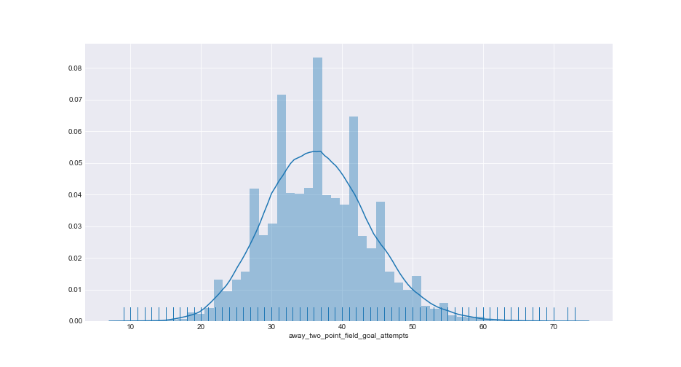
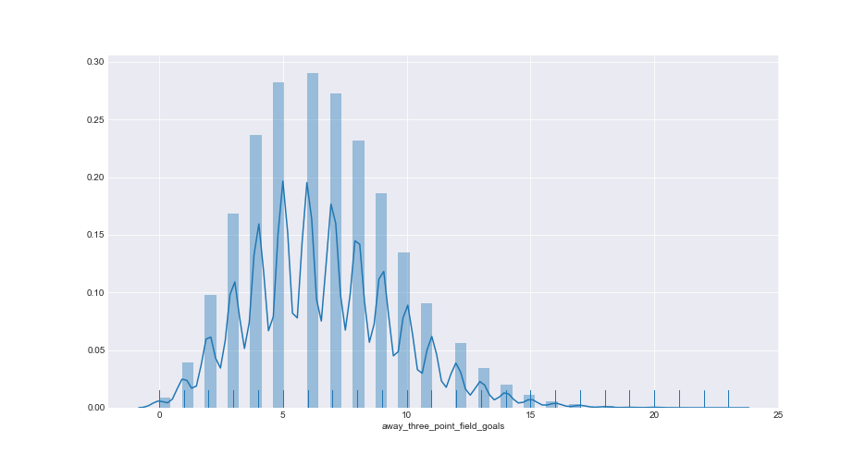
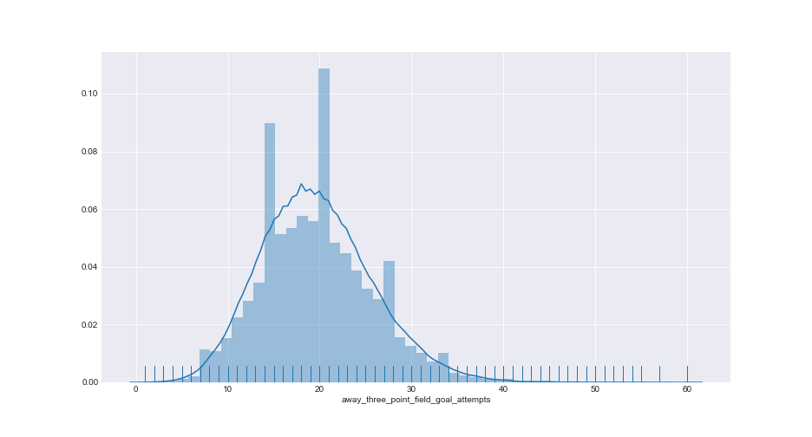
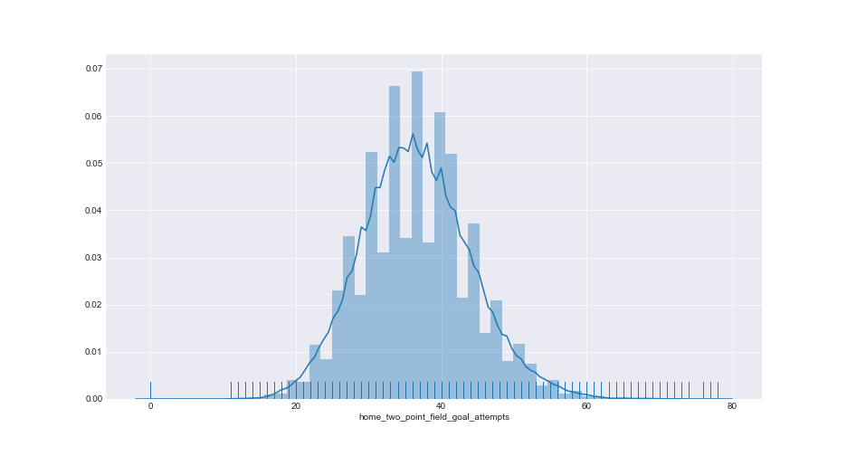
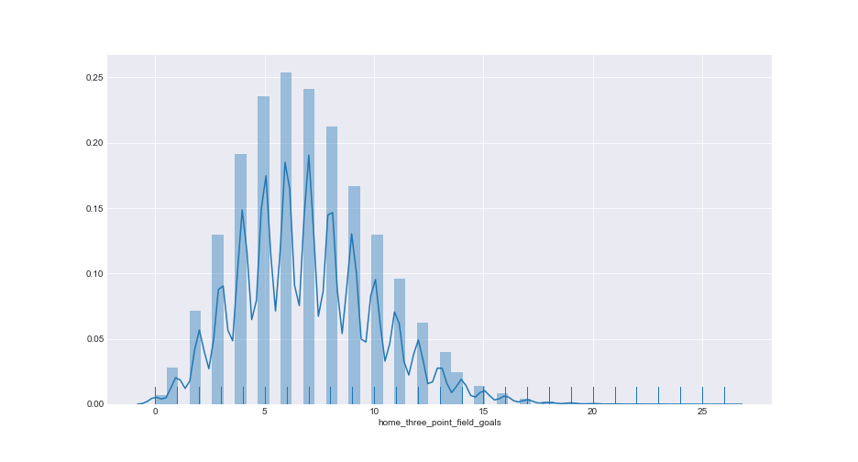
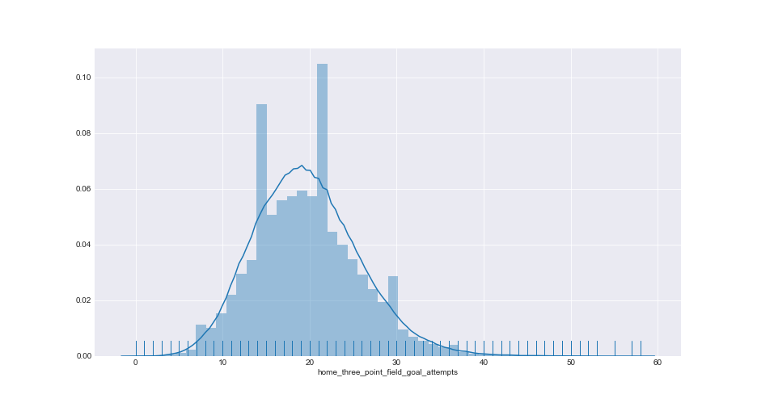
Collection – Cleansing – Compilation
2 Pt FG Attempts
3 Pt FG Made
3 Pt FG Attempts
Away
Home

Slide 17
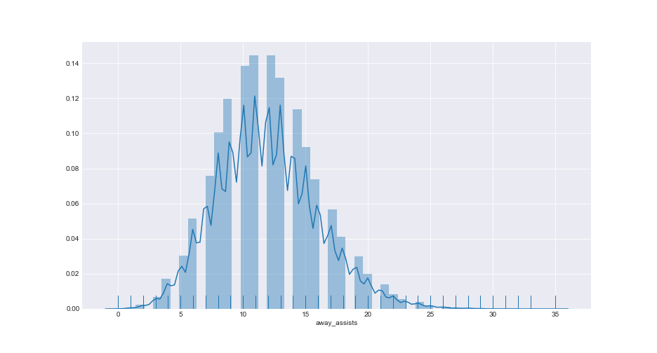
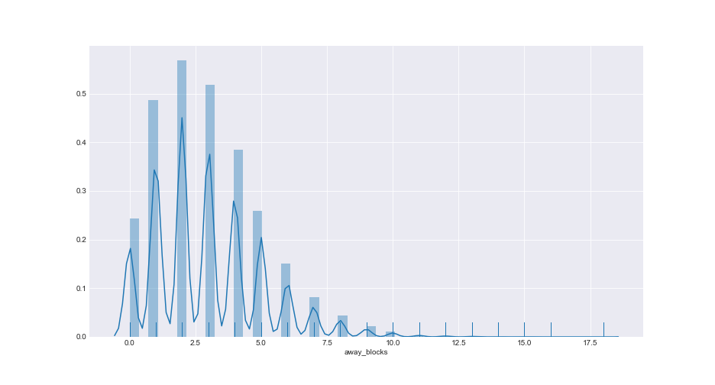
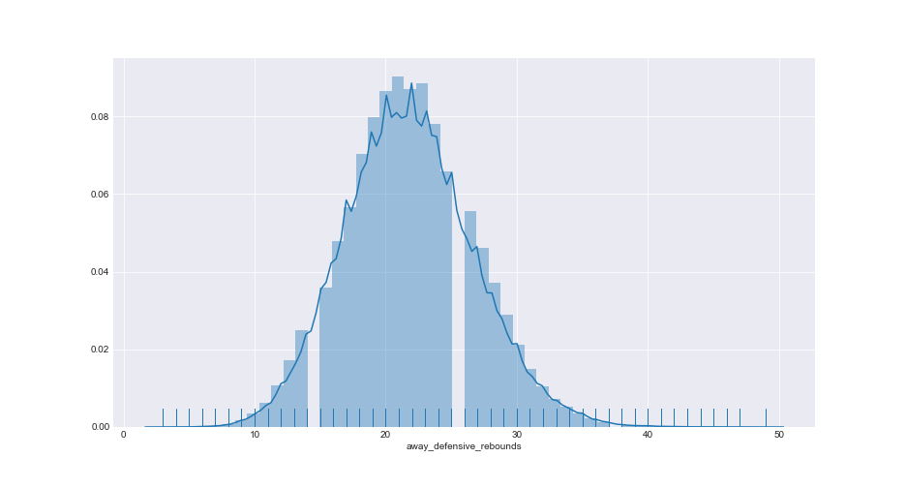
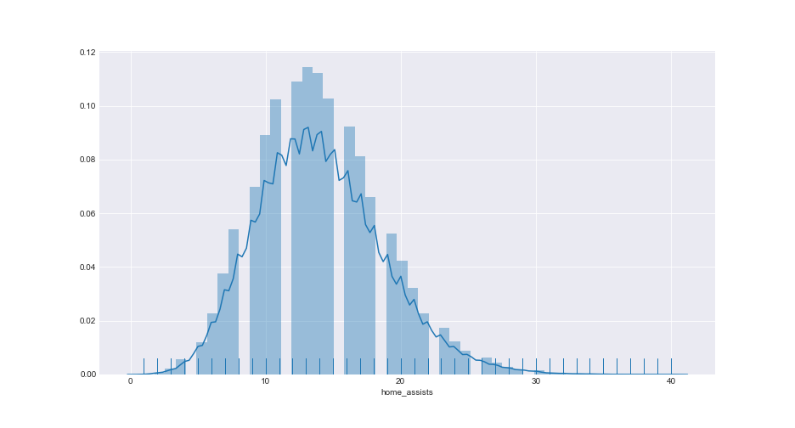
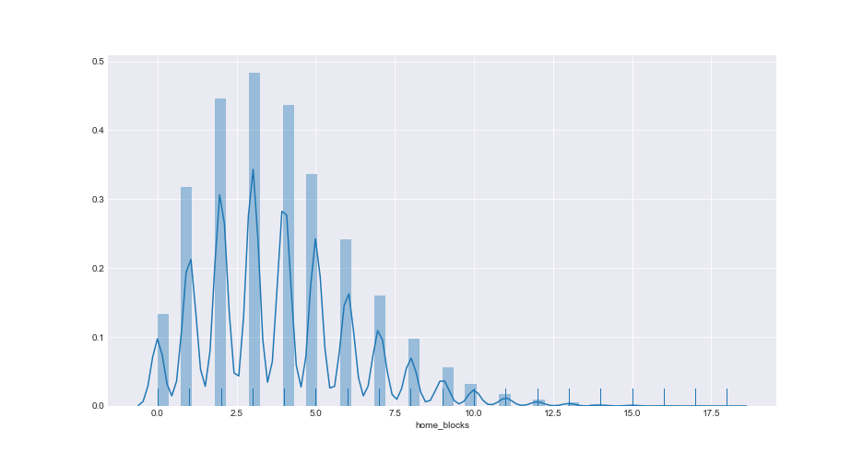
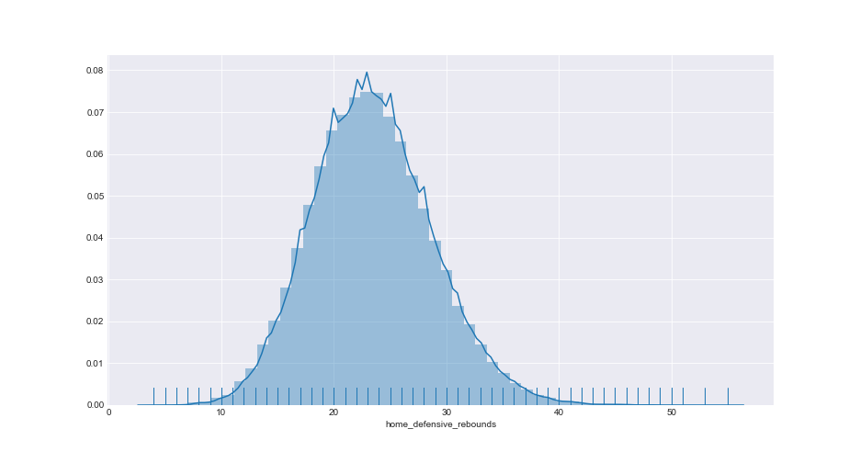
Collection – Cleansing – Compilation
Assists
Blocks
Defensive Rebounds
Away
Home

Slide 18
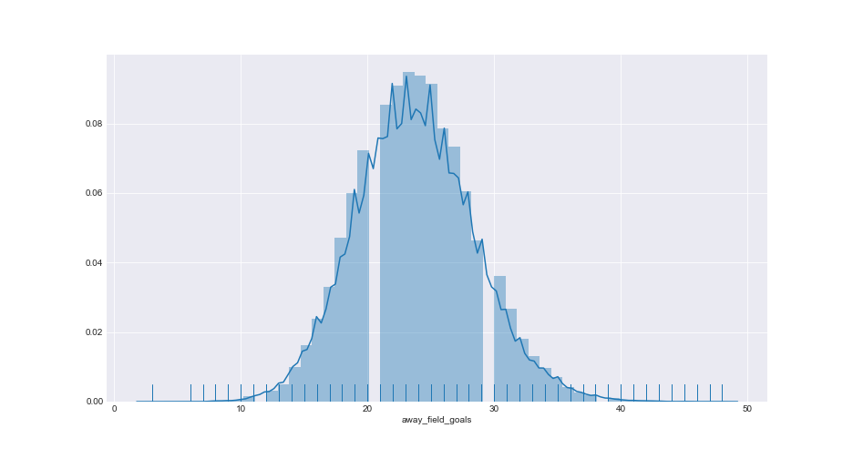
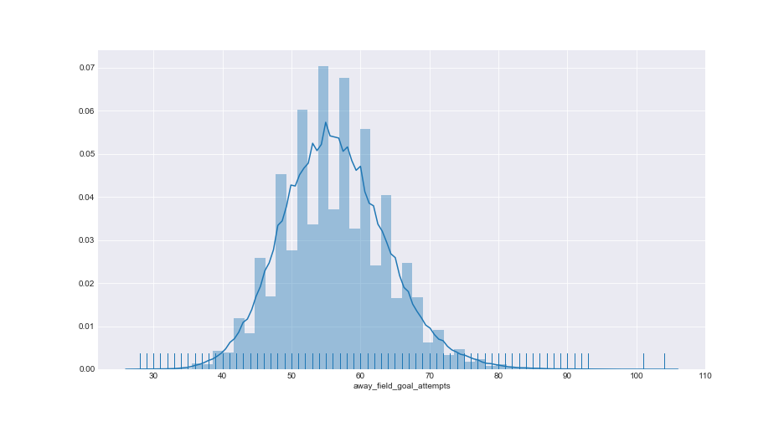
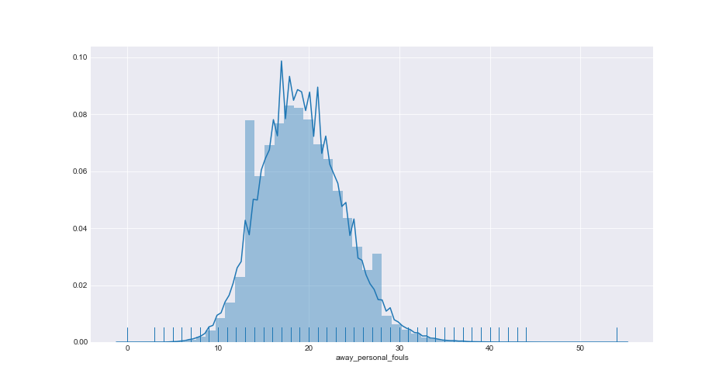
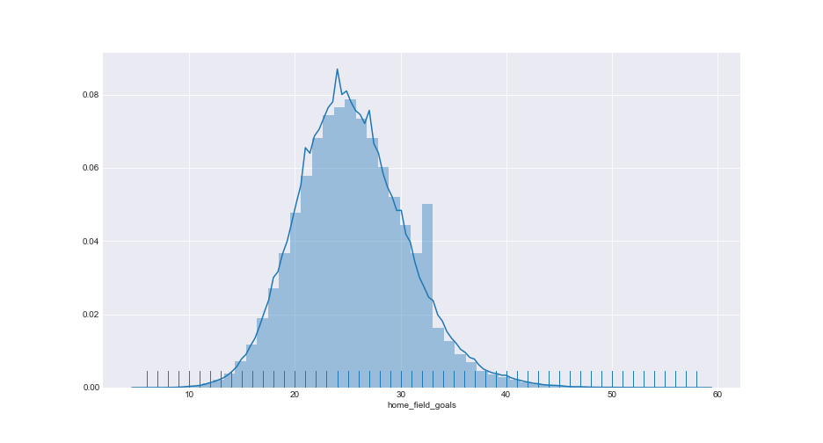

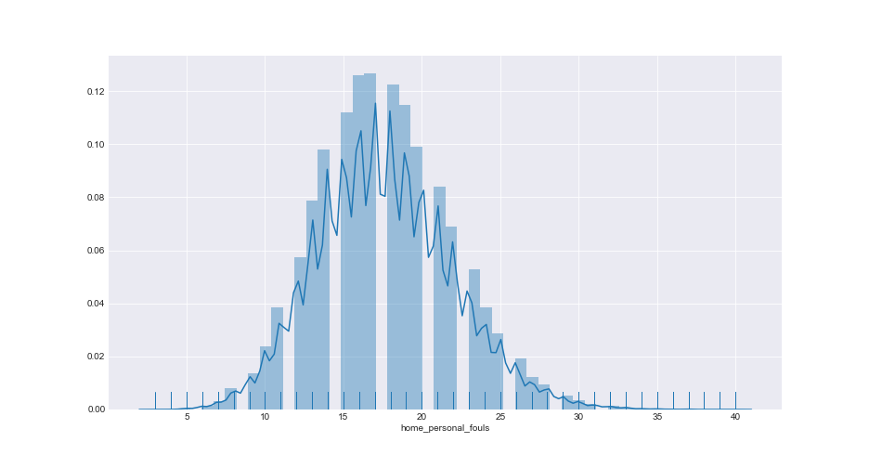
Collection – Cleansing – Compilation
Field Goals
Field Goal Attempts
Fouls
Away
Home

Slide 19
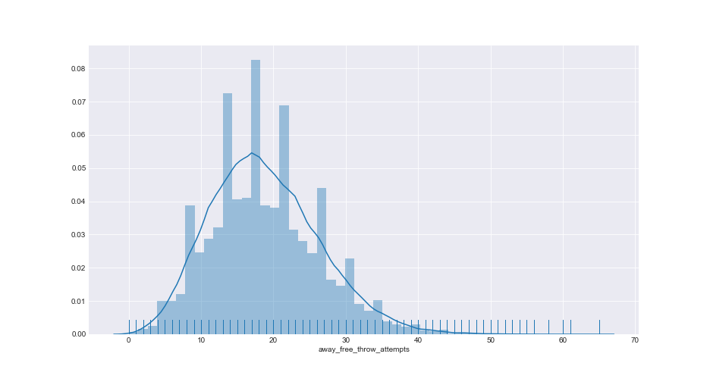
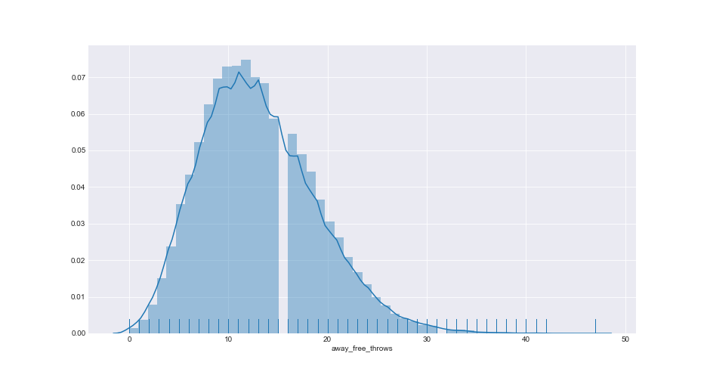
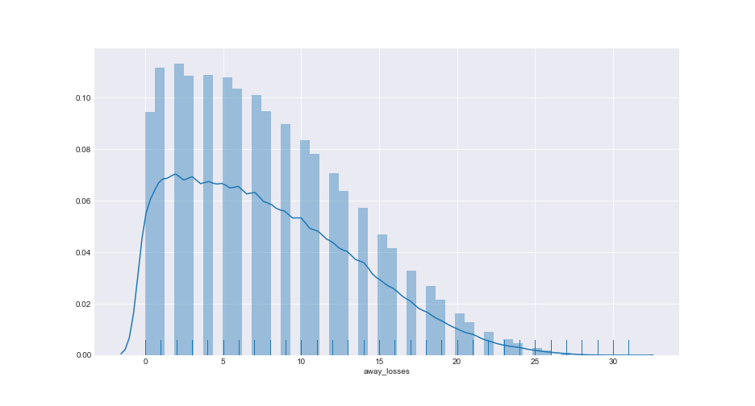
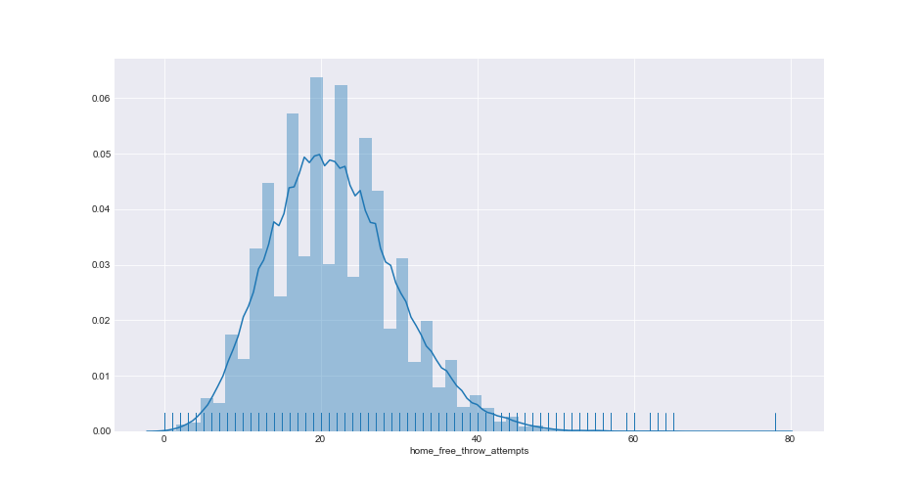
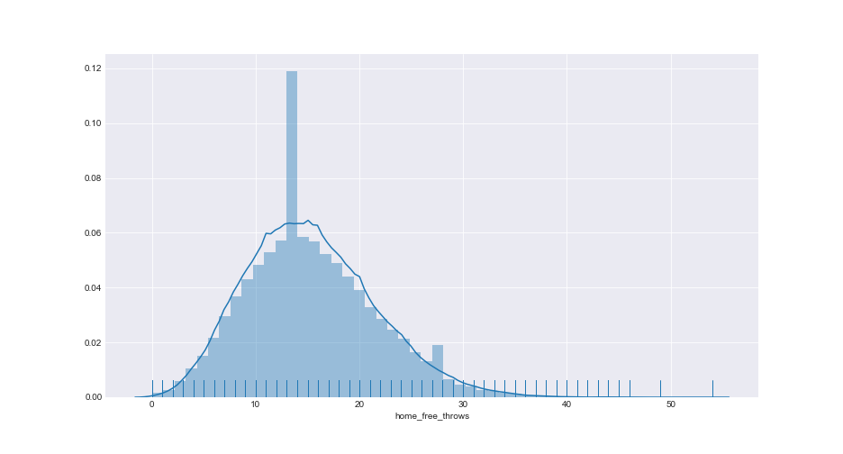
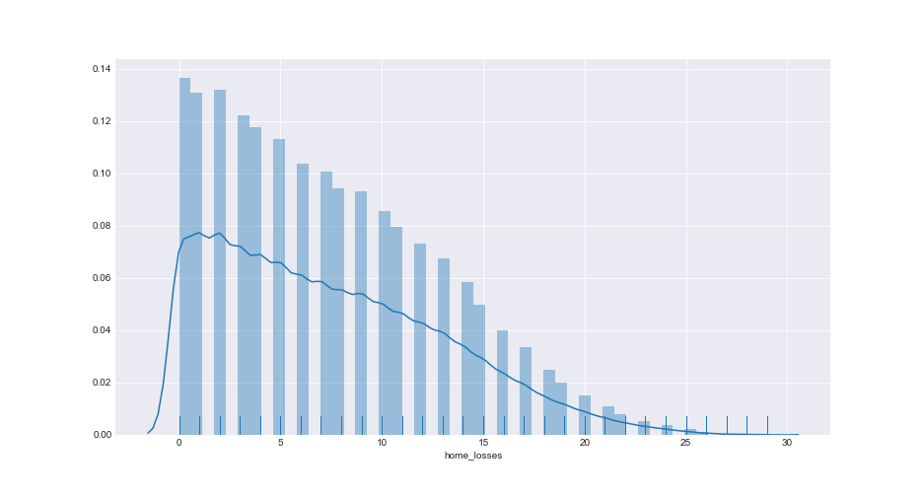
Collection – Cleansing – Compilation
Field Goals
Field Goal Attempts
Fouls
Away
Home

Slide 20
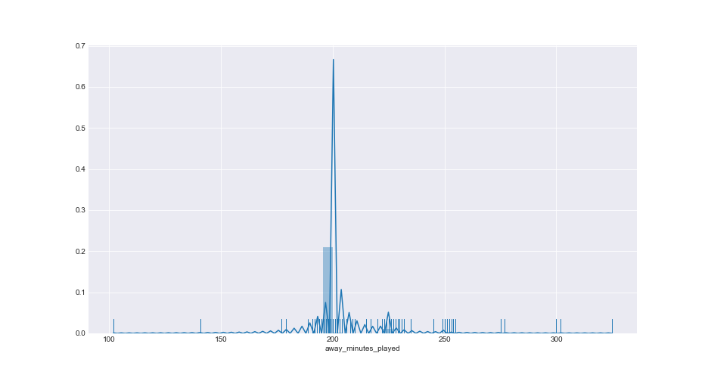
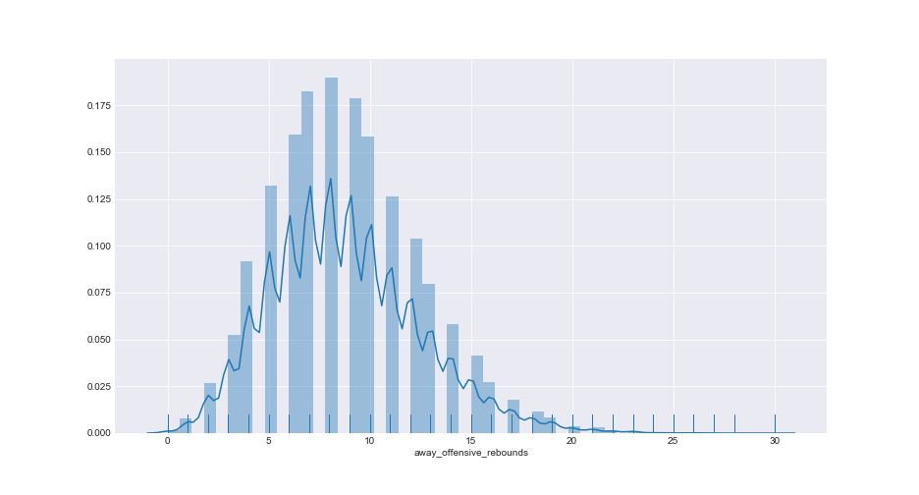
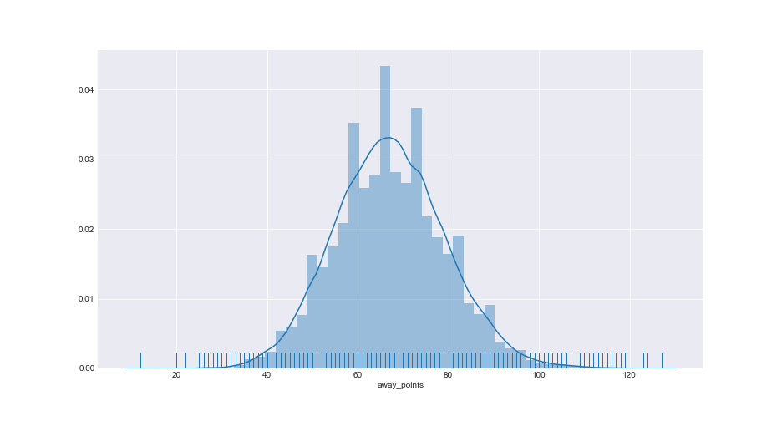
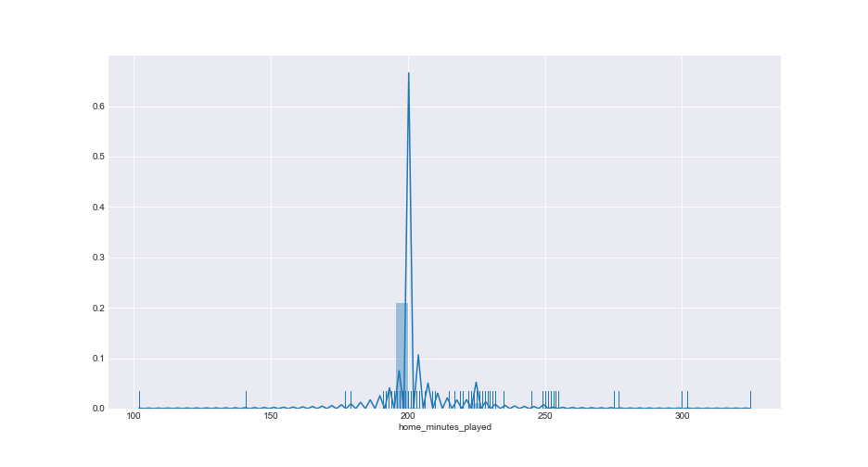
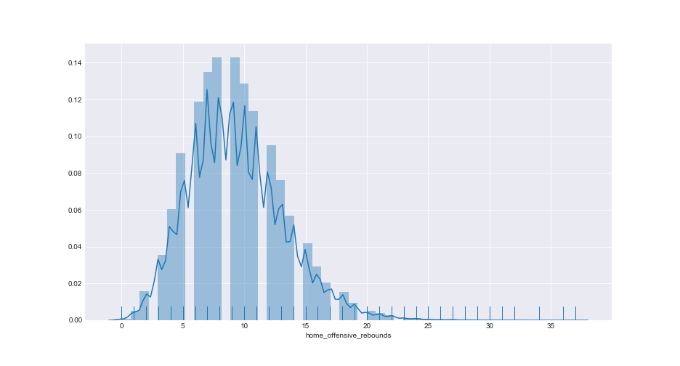
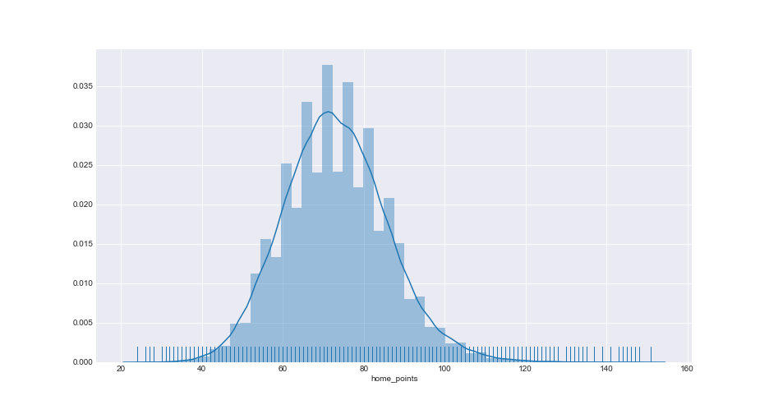
Collection – Cleansing – Compilation
Minutes Played
Offensive Rebounds
Points Scored
Away
Home

Slide 21
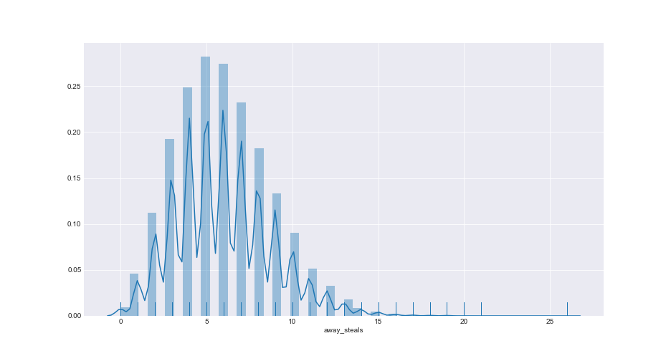
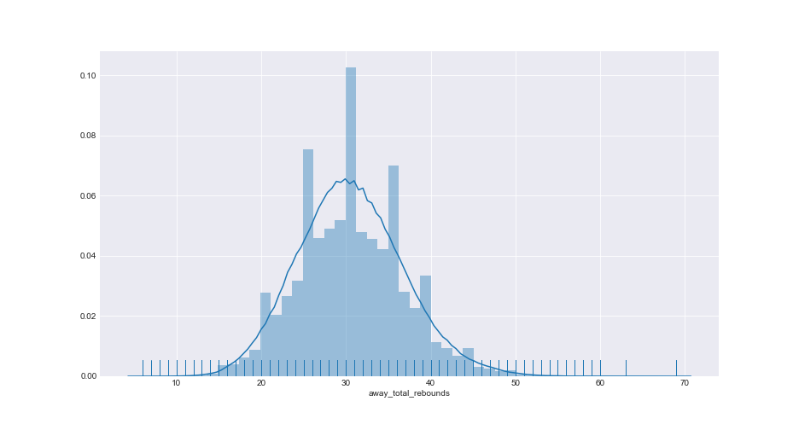
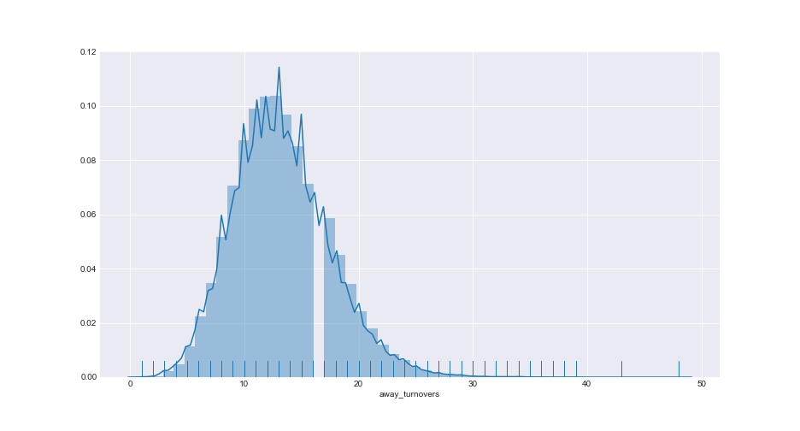
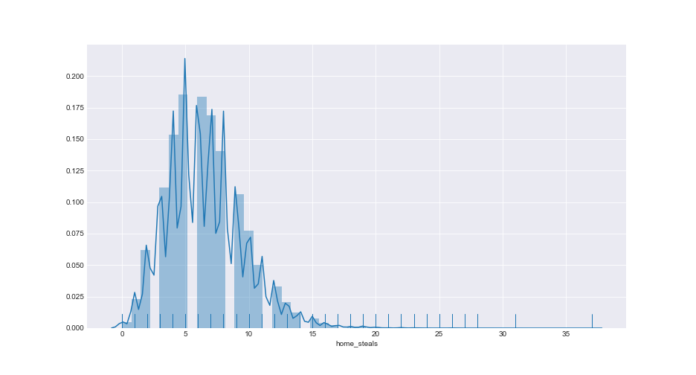
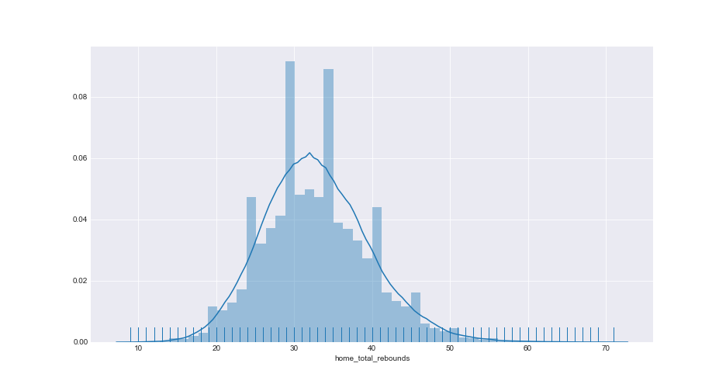
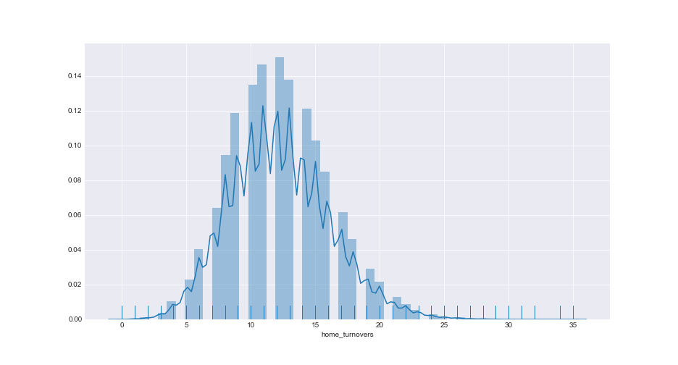
Collection – Cleansing – Compilation
Steals
Total Rebounds
Turnovers
Away
Home

Slide 22
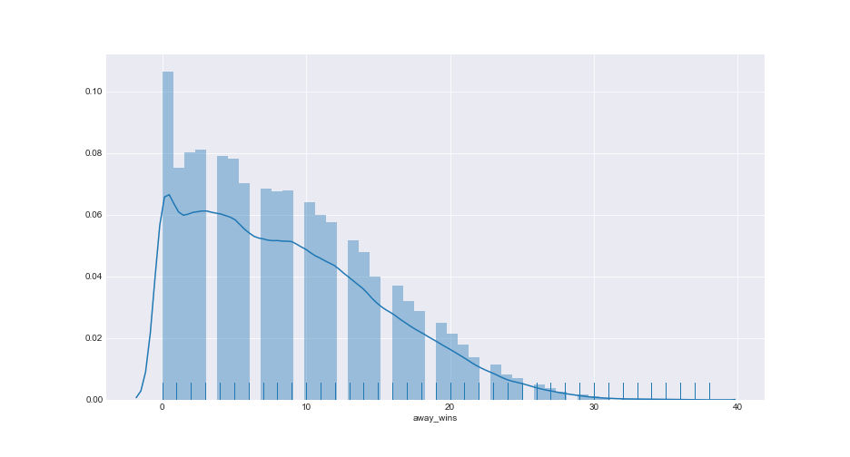
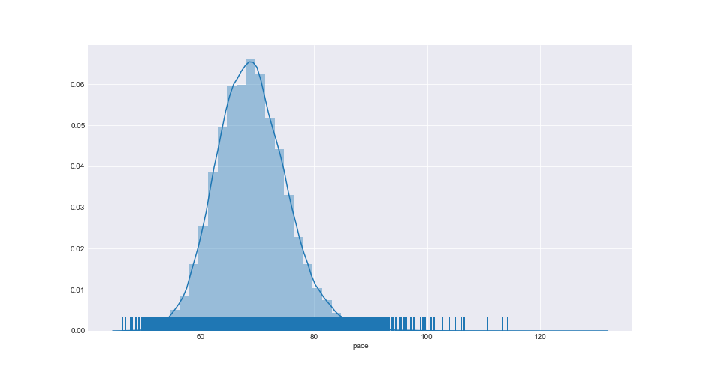
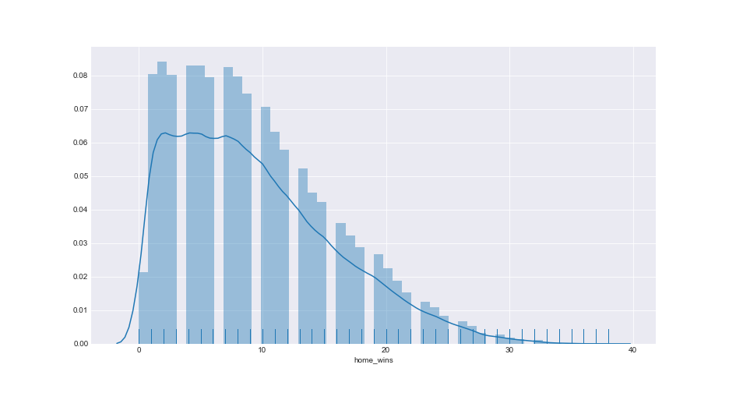
Collection – Cleansing – Compilation
Wins
Game Pace (Est Possessions/40 minutes)
Away
Home

Slide 23
Collection – Cleansing – Compilation
Compute vectors for every team at the time of each game
Season-to-date statistics
Expanding mean
Exponential weighted mean
Weighted sums

Slide 24
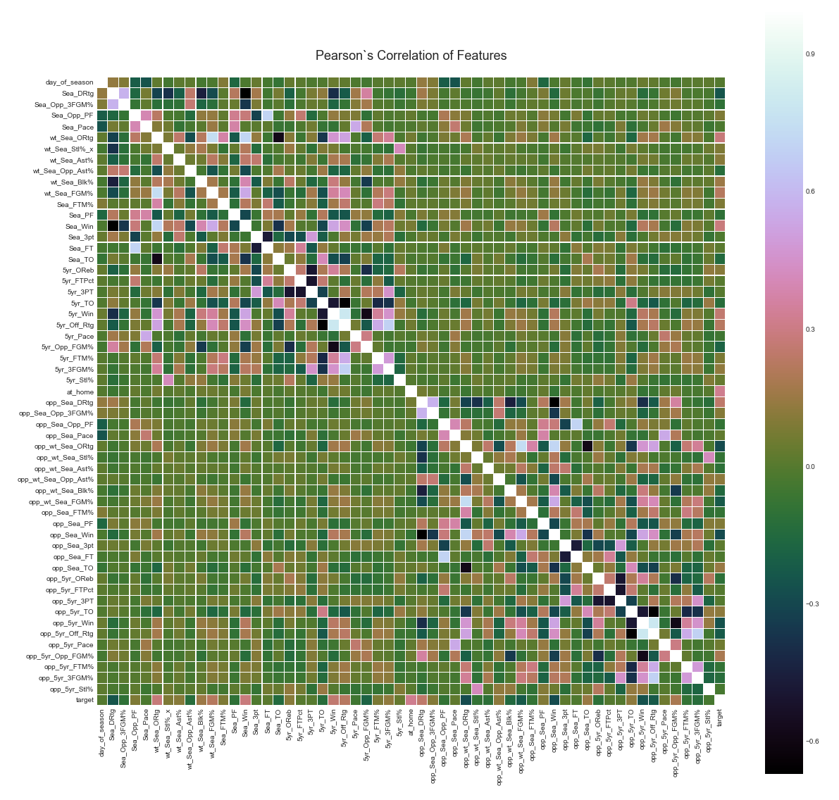
Pearson’s Correlation
Look across the feature set to visualize which features show the greatest positive and negative correlation.
Illustrates strong positive correlations between offensive ratings and wins.
Strong negative correlation between turnover rates and wins.

Slide 25
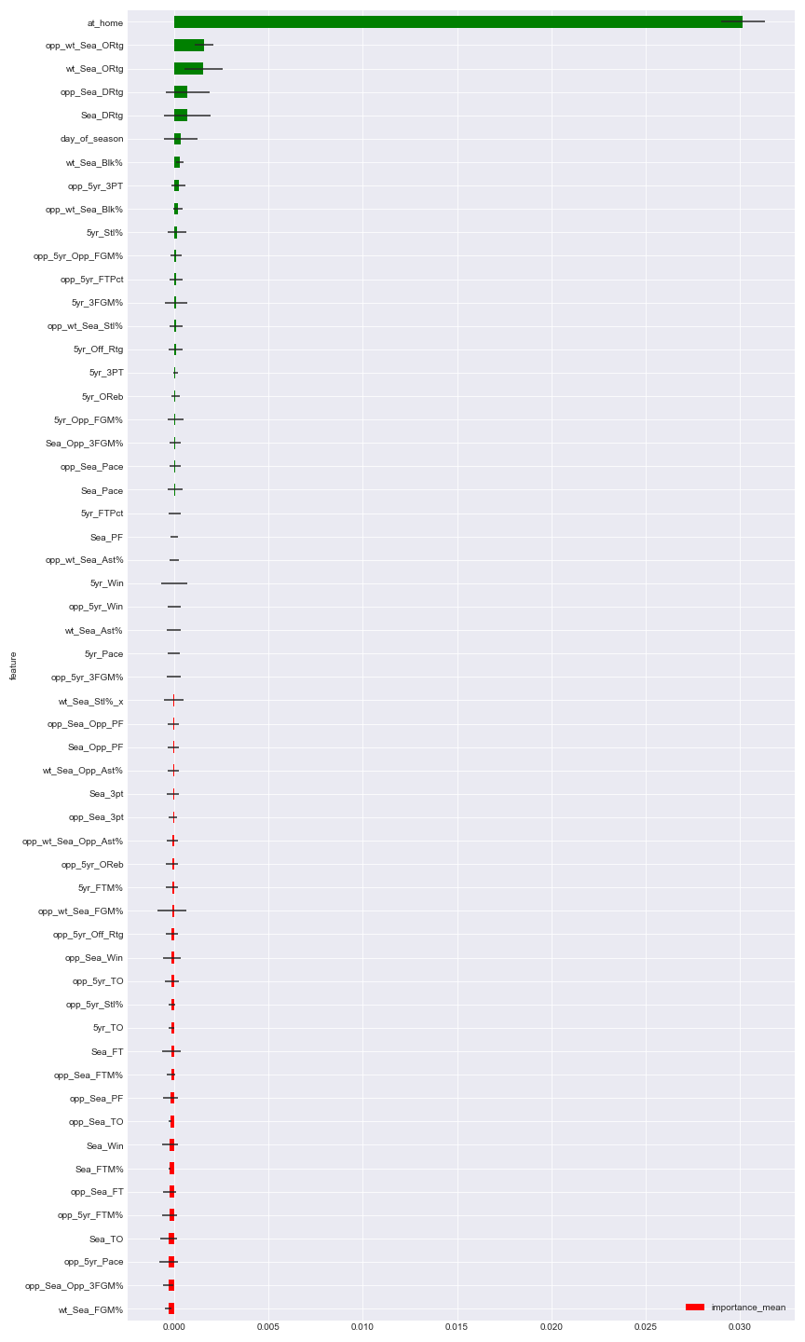
LOFO Importance (Leave One Feature Out)
Evaluates the performance of the model with all the input features included.
Iteratively removes one feature at a time, retrains the model, and evaluates its performance on a validation set.
The mean and standard deviation (across the folds) of the importance of each feature is then reported.

Slide 26
Model
k-Fold Cross Validation
Assign a k-parameter for the number of groups the data sample will be split into
Purpose is to use a limited sample to estimate how the model is expected to perform in general when used to make predictions on data not used during the training of the model
Less biased estimate of the model skill than other methods, like a train/test split.
Random shuffle of the dataset.
Split the dataset into k groups.
For each unique group:
Take the group as a hold out or test data set
Take the remaining groups as a training data set
Fit a model on the training set and evaluate it on the test set
Retain the evaluation score and discard the model
Summarize the skill of the model using the sample of model evaluation scores

Slide 27
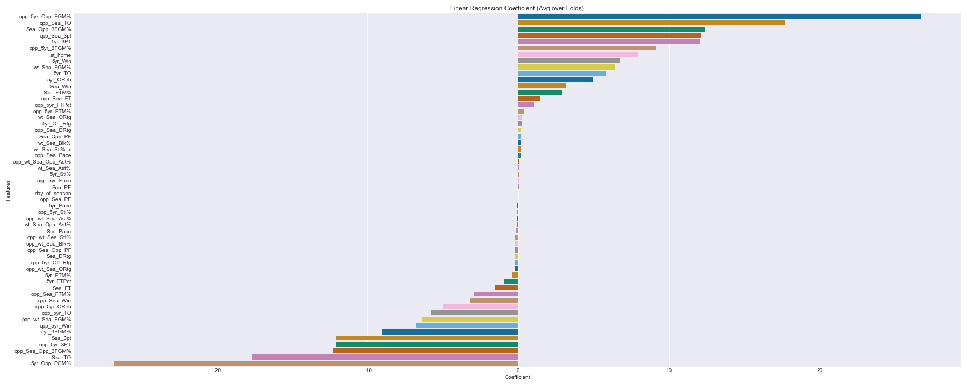
Linear Regression Coefficient (Avg over 5 folds)
Perform 5-fold cross validation to find mean absolute error across our original set of features.
Mean linear regression score across the 5 folds = 9.1135
Standard deviation = 0.1409
Basic linear regression score is 0.5095 points away from Vegas opening line mean error (8.604), and 0.5875 from closing (8.526).

Slide 28

Light Gradient Boosting Framework (Avg over 5 folds)
LightGBM using the k-fold Cross Validation provides us with what the model believes are the most important features.
LGBM focuses on accuracy of results.
LGBM mean regression score across the 5 folds = 9.0311
Standard deviation = 0.1431
LGBM regression score is 0.4271 points away from Vegas opening line mean error (8.604), and 0.5051 from closing (8.526).

Slide 29
Neural Network
Not necessarily a useful method for this type of data
Data features are highly linear in nature
Did it anyway to see if it was worthwhile
Used standard dense layers, but used “dropout” as well
Dropout randomly drops a percentage of neurons to prevent overfitting.
Chose a 20% dropout rate
Continued use of 5-fold cross validation
200 epochs and batch size of 64

Slide 30
How did we do?
Light GBM regression worked best
Didn’t perform well enough for the current model to be viable
Neural network did not net better results and cost in run time
Partially due to linear nature of the data, partially on feature optimization
Line Source | Mean Absolute Error
Book – Opening Line | 8.604
Book – Closing Line | 8.526
SK-Learn Linear Regression | 9.114
Light GBM Model Regression | 9.031
Neural Network | 9.153

Slide 31
Next steps?
Add additional feature information
Strength of schedule
Team rosters & player metrics (height/weight)
Individual player statistics
Recruiting rankings

